Slide 1
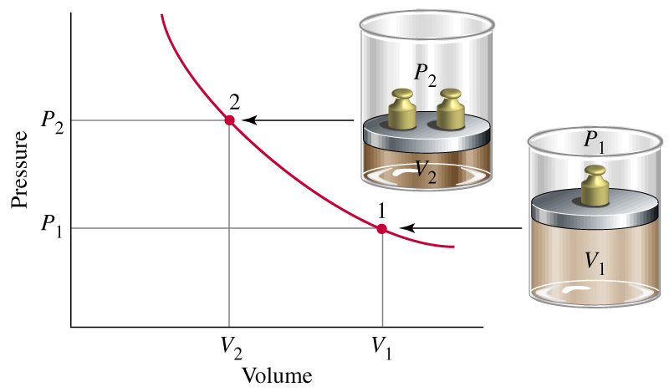
Chapter 5: Gases
General Chemistry
Prentice-Hall © 2002
General Chemistry: Chapter 5
Slide <number> of 41
Notes:
Chemistry 140 Fall 2002
Iron rusts
Natural gas burns
Represent chemical reactions by chemical equations.
Relationship between reactants and products is STOICHIOMETRY
Many reactions occur in solution-concentration uses the mole concept to describe solutions

Slide 2
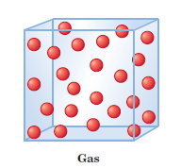
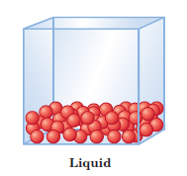
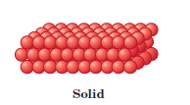
Sates of Matter
Molecules far apart
and disordered
Negligible interactions
between molecules
Intermediate situation
Molecules close together
and ordered
Strong interactions
between molecules
Prentice-Hall © 2002
General Chemistry: Chapter 5
Slide <number> of 41

Slide 3
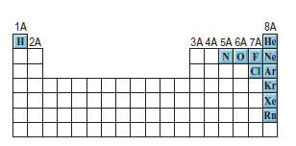
Gas
The noble gases
(the Group 8A elements) are
monatomic species; the other
elements exist as diatomic
molecules.
N₂ =78 %,
O₂ = 21%,
Other gases =1 %
(Ar, CO₂, Ne, He, CH₄, Kr)
Prentice-Hall © 2002
General Chemistry: Chapter 5
Slide <number> of 41

Slide 4
What is gas?
A gas consists of molecules in rapid, random motion.
The pressure a gas exerts on a surface, such as the walls of a container,
results from the continual bombardment on the walls of the container by
the rapidly moving gas molecules.
We use an instrument called a barometer to measure atmospheric
pressure.
Prentice-Hall © 2002
General Chemistry: Chapter 5
Slide <number> of 41

Slide 5


Gas
Gases exert pressure on any surface with which they come in contact,
because gas molecules are constantly in motion
What is pressure?
Pressure is defined as the force exerted per unit area of surface
SI unit of pressure is pascal (Pa)
Prentice-Hall © 2002
General Chemistry: Chapter 6
Slide <number> of 41

Slide 6
Unit of Gas Pressure
Common pressure units are:
millimeter of mercury (mm Hg) and
atmosphere (atm)
Atmospheric pressure is the pressure exerted by Earth’s atmosphere
Standard atmospheric pressure (1 atm) is equal to the pressure that
supports a column of mercury exactly 760 mm (or 76 cm) high at 0°C at
sea level.
In other words, the standard atmosphere equals a pressure of 760 mmHg,
where mmHg represents the pressure exerted by a column of mercury
1 mm high. The mmHg unit is also called the torr
Prentice-Hall © 2002
General Chemistry: Chapter 6
Slide <number> of 41

Slide 7





Unit of Gas Pressure
Relation between atmospheres and pascals
Prentice-Hall © 2002
General Chemistry: Chapter 6
Slide <number> of 41

Slide 8
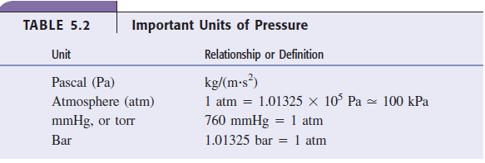
Unit of Gas Pressure
Prentice-Hall © 2002
General Chemistry: Chapter 6
Slide <number> of 41

Slide 9

Gas Law: Boyle’s law
In the seventeenth century, the British chemist Robert Boyle
studied the behavior of gases
Boyle investigated the pressure-volume relationship of a gas
According to Boyle’s law, the volume of a sample of gas at a
given temperature varies inversely with the applied pressure
PV = constant
Prentice-Hall © 2002
General Chemistry: Chapter 6
Slide <number> of 41

Slide 10
Boyle’s law
You can use Boyle’s law to calculate the volume occupied by a gas when
the pressure changes
Prentice-Hall © 2002
General Chemistry: Chapter 6
Slide <number> of 41

Slide 11
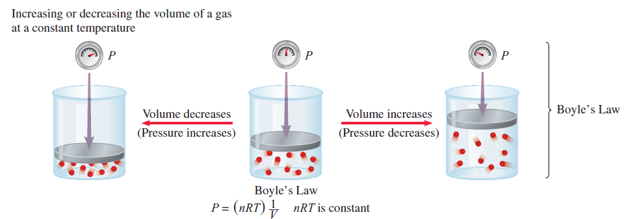
Boyle’s law
Prentice-Hall © 2002
General Chemistry: Chapter 6
Slide <number> of 41

Slide 12


Boyle’s law
Because the temperature does not change, the product of the
pressure and volume remains constant. Thus, you can write
Prentice-Hall © 2002
General Chemistry: Chapter 6
Slide <number> of 41

Slide 13

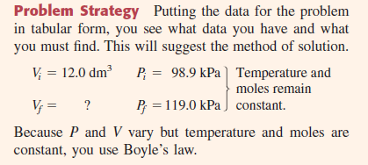
Problem
Prentice-Hall © 2002
General Chemistry: Chapter 6
Slide <number> of 41

Slide 14

Solution of Problem
Prentice-Hall © 2002
General Chemistry: Chapter 6
Slide <number> of 41

Slide 15

Charles’s Law
Charles’s Law: Relating Volume and Temperature
Temperature also affects gas volume
Charles’s law sates that the volume occupied by any sample
of gas at a constant pressure is directly proportional to the
absolute temperature.
Thus, doubling the absolute temperature of a gas doubles its
volume
Prentice-Hall © 2002
General Chemistry: Chapter 6
Slide <number> of 41

Slide 16

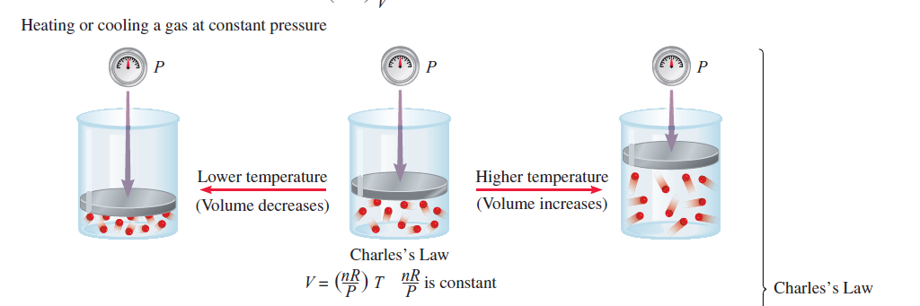
Charles’s Law
Prentice-Hall © 2002
General Chemistry: Chapter 6
Slide <number> of 41

Slide 17


Charles’s Law
Consider a sample of gas at a fixed pressure, and suppose the
temperature changes from its initial value Ti to a final value Tf.
How does the volume change?
Because the volume divided by absolute temperature is constant,
you can write
Rearranging,
Prentice-Hall © 2002
General Chemistry: Chapter 6
Slide <number> of 41

Slide 18
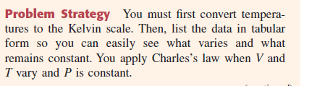

Problem
Total volume of oxygen that can be obtained from a particular tank at
1.00 atm and 21°C is 785 L (including the volume remaining in the tank).
What would be this volume of oxygen if the temperature had been 28°C?
Prentice-Hall © 2002
General Chemistry: Chapter 6
Slide <number> of 41

Slide 19
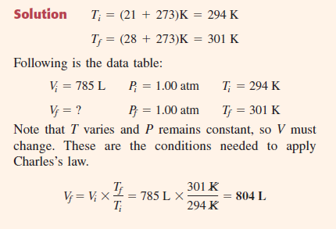
Solve
Prentice-Hall © 2002
General Chemistry: Chapter 6
Slide <number> of 41

Slide 20
STP
Gas properties depend on conditions.
Define standard conditions of temperature and pressure (STP).
P = 1 atm = 760 mm Hg
T = 0°C = 273.15 K
Prentice-Hall © 2002
General Chemistry: Chapter 6
Slide <number> of 41

Slide 21
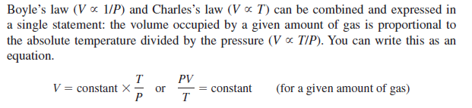
Combined Gas Law: Relating Volume, Temperature, and Pressure
Combined Gas Law: Relating Volume, Temperature, and Pressure
Prentice-Hall © 2002
General Chemistry: Chapter 6
Slide <number> of 41

Slide 22


Combined Gas Law: Relating Volume, Temperature, and Pressure
Consider a problem in which you wish to calculate the final volume of a
gas when the pressure and temperature are changed.
PV/T is constant for a given amount of gas, so you can write
Rearranging,
Prentice-Hall © 2002
General Chemistry: Chapter 6
Slide <number> of 41

Slide 23
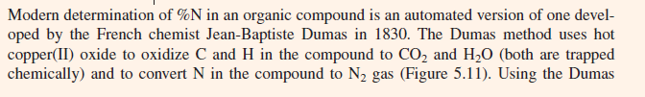
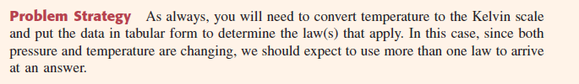
Problem
Prentice-Hall © 2002
General Chemistry: Chapter 6
Slide <number> of 41

Slide 24
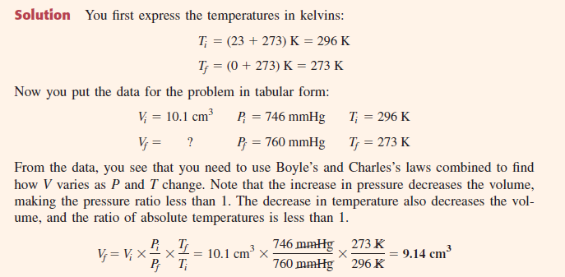
Solve
Prentice-Hall © 2002
General Chemistry: Chapter 6
Slide <number> of 41

Slide 25
Avogadro’s Law
Avogadro’s Law: Relating Volume and Amount
In 1811Avogadro published a hypothesis stating that
at the same temperature and pressure, equal volumes of different gases
contain the same number of molecules (or atoms if the gas is
monatomic).
It follows that the volume of any given gas must be proportional to
the number of moles of molecules present
Prentice-Hall © 2002
General Chemistry: Chapter 6
Slide <number> of 41

Slide 26

Avogadro’s law
Avogadro’s law:
Equal volumes of any two gases at the same temperature and
pressure contain the same number of molecules
Prentice-Hall © 2002
General Chemistry: Chapter 6
Slide <number> of 41

Slide 27
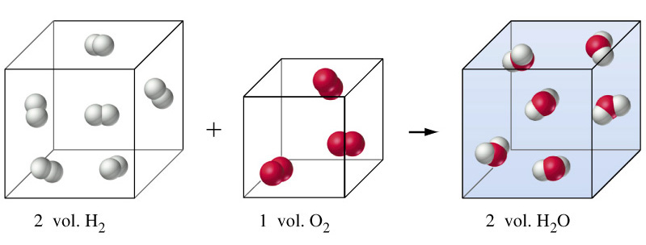
Formation of Water
Thus, two volumes of hydrogen contain twice the number of
molecules as in one volume of oxygen, in agreement with the chemical
equation for the reaction.
Prentice-Hall © 2002
General Chemistry: Chapter 6
Slide <number> of 41
Notes:
Chemistry 140 Fall 2002
Dalton thought H + O → HO so ratio should have been 1:1:1. So the second part of Avogadro’s hypothesis is critical.
This identifies the relationship between stoichiometry and gas volume.

Slide 28
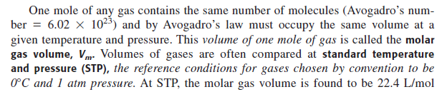
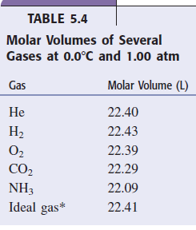

Avogadro’s Law
At STP
1 mol gas = 22.4 L gas
Prentice-Hall © 2002
General Chemistry: Chapter 6
Slide <number> of 41

Slide 29
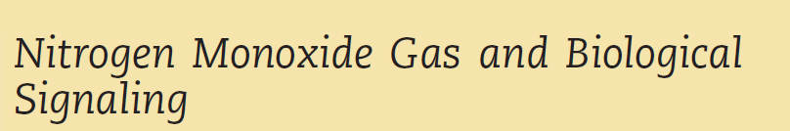
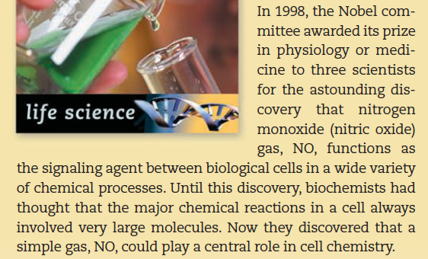
Application of NO
Prentice-Hall © 2002
General Chemistry: Chapter 6
Slide <number> of 41

Slide 30
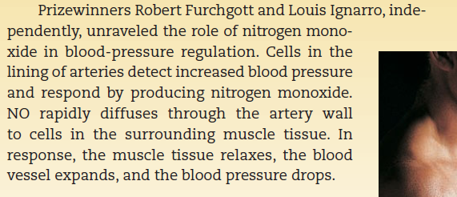
Nitrogen Monoxide Gas
Prentice-Hall © 2002
General Chemistry: Chapter 6
Slide <number> of 41

Slide 31

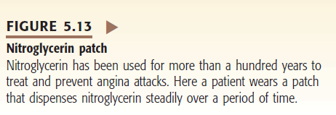
Nitrogen Monoxide Gas
Prentice-Hall © 2002
General Chemistry: Chapter 6
Slide <number> of 41

Slide 32
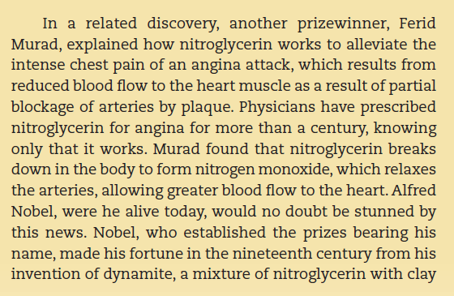
Nitrogen Monoxide Gas
Prentice-Hall © 2002
General Chemistry: Chapter 6
Slide <number> of 41

Slide 33
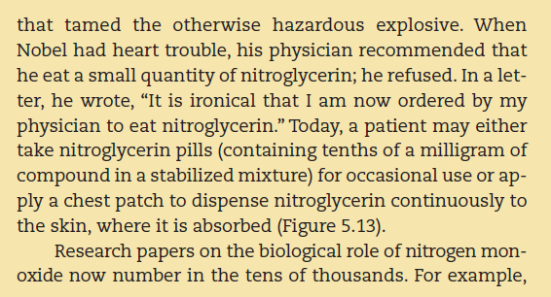
Nitrogen Monoxide Gas
Prentice-Hall © 2002
General Chemistry: Chapter 6
Slide <number> of 41

Slide 34
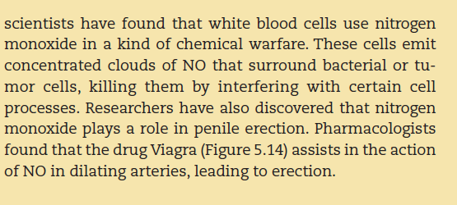
Nitrogen Monoxide Gas
Prentice-Hall © 2002
General Chemistry: Chapter 6
Slide <number> of 41

Slide 35
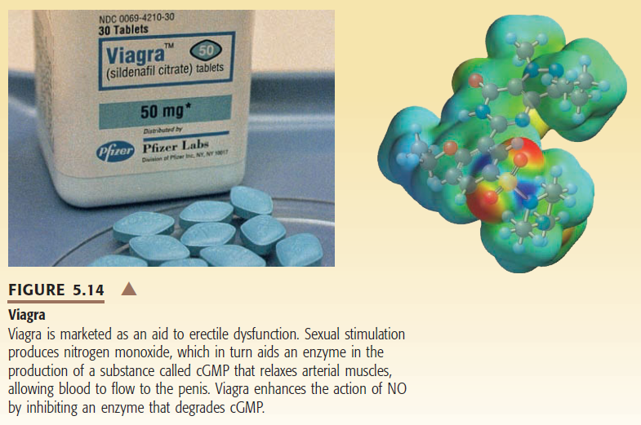
Nitrogen Monoxide Gas
Prentice-Hall © 2002
General Chemistry: Chapter 6
Slide <number> of 41

Slide 36
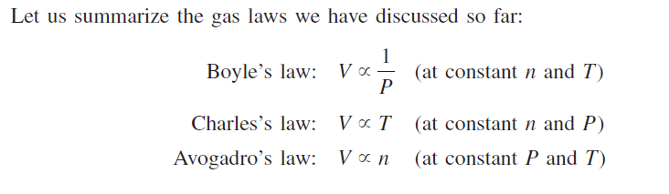

Ideal Gas Equation
We can combine all three expressions to form a single master
equation for the behavior of gases:
Prentice-Hall © 2002
General Chemistry: Chapter 6
Slide <number> of 41

Slide 37



Ideal Gas Equation
Or,
Prentice-Hall © 2002
General Chemistry: Chapter 6
Slide <number> of 41

Slide 38
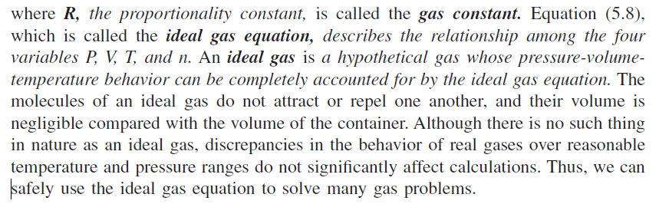
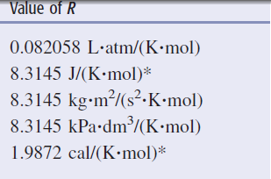
Ideal Gas Equation
Prentice-Hall © 2002
General Chemistry: Chapter 6
Slide <number> of 41

Slide 39
Ideal Gas Equation
At 0°C (273.15 K) and 1 atm pressure, many real gases behave
like an ideal gas.
Experiments show that under these conditions, 1 mole of an ideal
gas occupies 22.414 L,
The conditions 0°C and 1 atm are called standard temperature
and pressure, often abbreviated STP
Prentice-Hall © 2002
General Chemistry: Chapter 6
Slide <number> of 41

Slide 40
The Gas Constant
PV = nRT
PV
R =
nT
= 0.082057 L atm mol⁻¹ K⁻¹
= 8.3145 m³ Pa mol⁻¹ K⁻¹
= 8.3145 m³ Pa mol⁻¹ K⁻¹
= 8.3145 J mol⁻¹ K⁻¹
Prentice-Hall © 2002
General Chemistry: Chapter 6
Slide <number> of 41

Slide 41
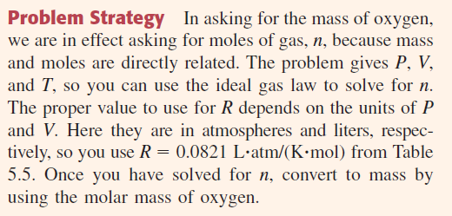
Problem
How many grams of oxygen, O₂, are there in a 50.0-L gas
cylinder at 21°C when the oxygen pressure is 15.7 atm?
Prentice-Hall © 2002
General Chemistry: Chapter 6
Slide <number> of 41

Slide 42
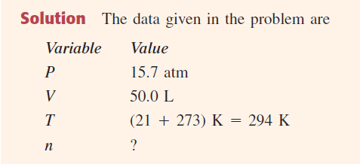
Solve
Prentice-Hall © 2002
General Chemistry: Chapter 6
Slide <number> of 41

Slide 43
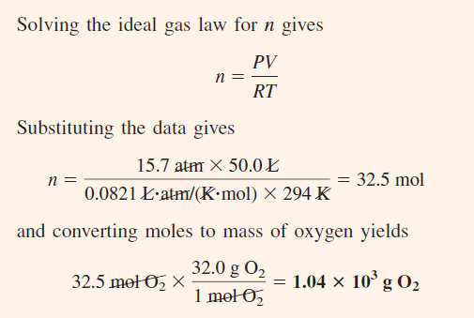
Solve
Prentice-Hall © 2002
General Chemistry: Chapter 6
Slide <number> of 41

Slide 44
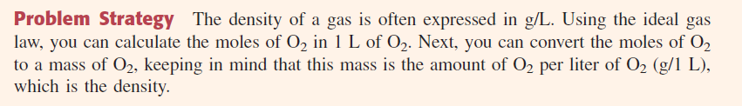
Gas Density; Molecular-Mass Determination
Prentice-Hall © 2002
General Chemistry: Chapter 6
Slide <number> of 41

Slide 45
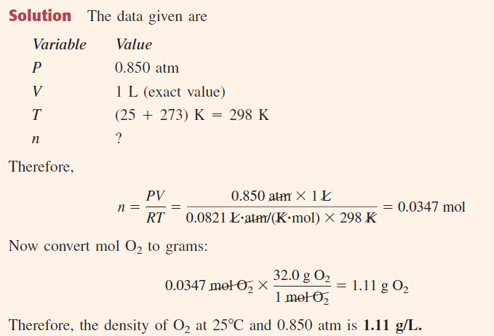
Solve
Prentice-Hall © 2002
General Chemistry: Chapter 6
Slide <number> of 41

Slide 46
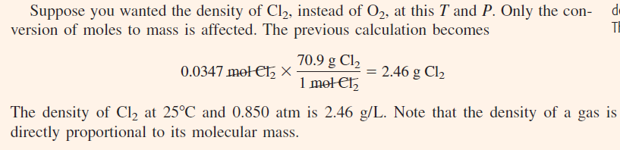
Solve
Prentice-Hall © 2002
General Chemistry: Chapter 6
Slide <number> of 41

Slide 47
Molar Mass Determination
m
PV = nRT
and
n =
M
m
PV =
RT
M
m
RT
M =
PV
Prentice-Hall © 2002
General Chemistry: Chapter 6
Slide <number> of 41

